Slide 1
NTE 1010
Introduction to Finance for Engineers
week 6
Interest Rates

Slide 2
NTE 1010 – Introduction to Finance for Engineers
Interest Rates
Present Value
Different debt instruments have
very different streams of cash payments to the holder (known as cash flows)
with very different timing.
We need to understand how we can compare
the value of one kind of debt instrument with another.
The concept of present value (or present discounted value) is based on
the commonsense notion that
a dollar paid to you one year from now is less valuable
than a dollar paid to you today.
This notion is true because
you can deposit a dollar today in a bank to earn interest
and have more than a dollar in one year.

Slide 3
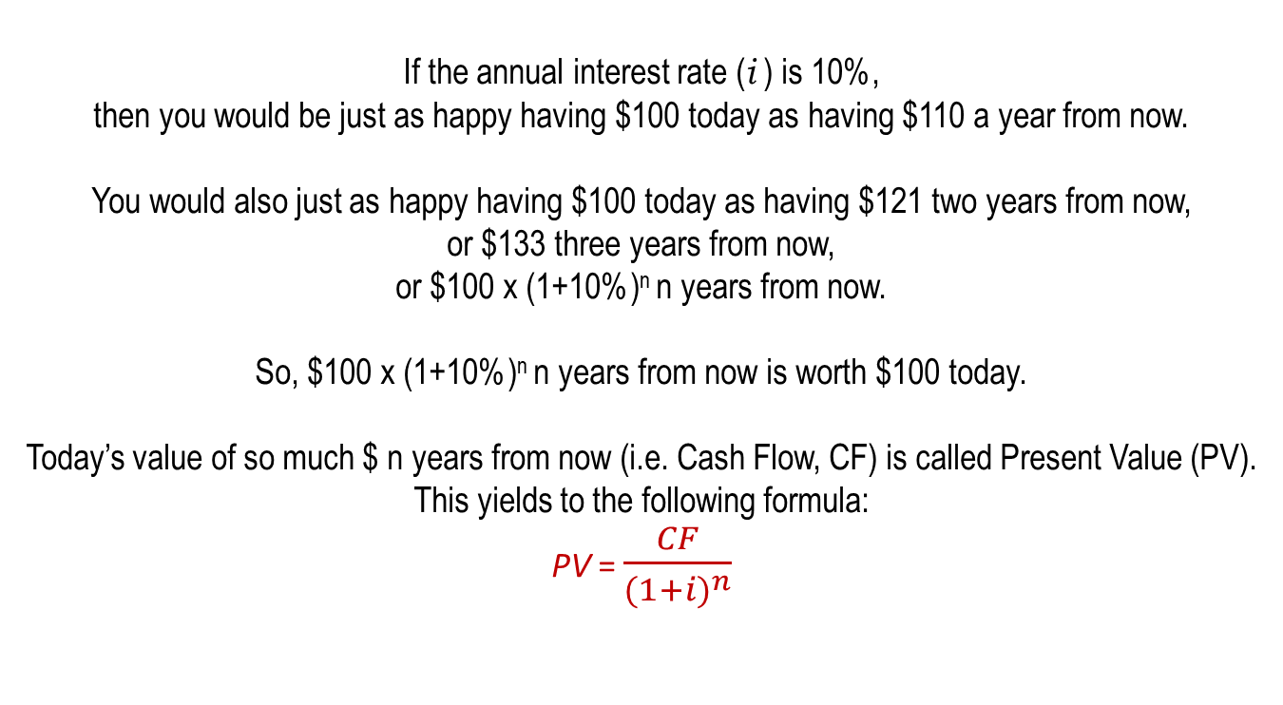
NTE 1010 – Introduction to Finance for Engineers
Interest Rates
Present Value
If the annual interest rate (i ) is 10%,
then you would be just as happy having $100 today as having $110 a year from now.
You would also just as happy having $100 today as having $121 two years from now,
or $133 three years from now,
or $100 x (1+10%)^{n} n years from now.
So, $100 x (1+10%)^{n} n years from now is worth $100 today.
Today’s value of so much $ n years from now (i.e. Cash Flow, CF) is called Present Value (PV).
This yields to the following formula:
PV = $\frac{CF}{{(1+i)}^{n}}$

Slide 4
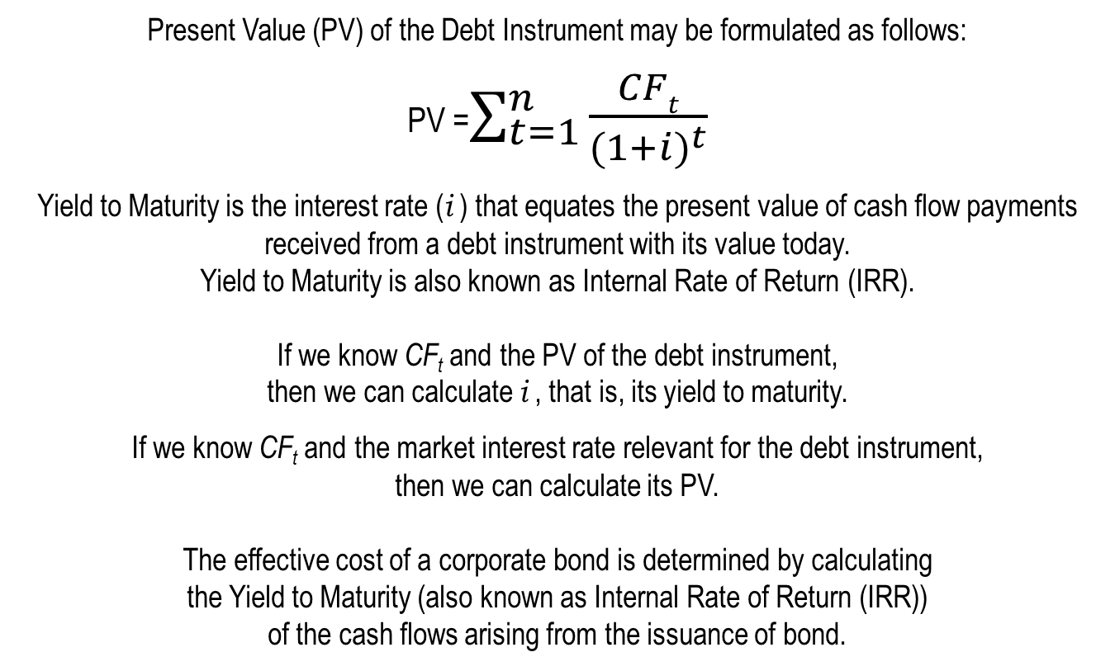
NTE 1010 – Introduction to Finance for Engineers
Interest Rates
Yield to Maturity
Present Value (PV) of the Debt Instrument may be formulated as follows:
PV =$\sum_{t=1}^{n}{\frac{CFt}{{(1+i)}^{t}}}$
Yield to Maturity is the interest rate (i ) that equates the present value of cash flow payments received from a debt instrument with its value today.
Yield to Maturity is also known as Internal Rate of Return (IRR).
If we know CF_{t} and the PV of the debt instrument,
then we can calculate i , that is, its yield to maturity.
If we know CF_{t} and the market interest rate relevant for the debt instrument,
then we can calculate its PV.
  The effective cost of a corporate bond is determined by calculating
  the Yield to Maturity (also known as Internal Rate of Return (IRR))
  of the cash flows arising from the issuance of bond.

Slide 5
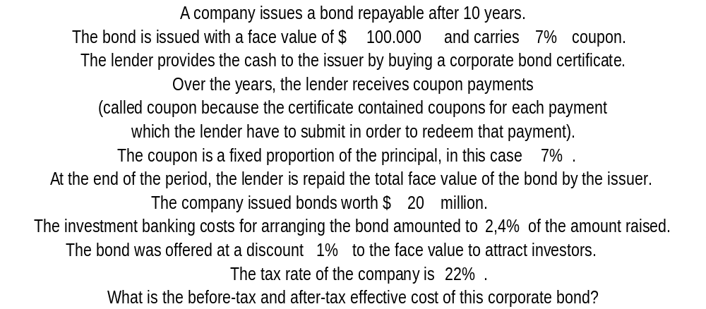
NTE 1010 – Introduction to Finance for Engineers
Yield to Maturity
Effective Cost of a Corporate Bond

Slide 6
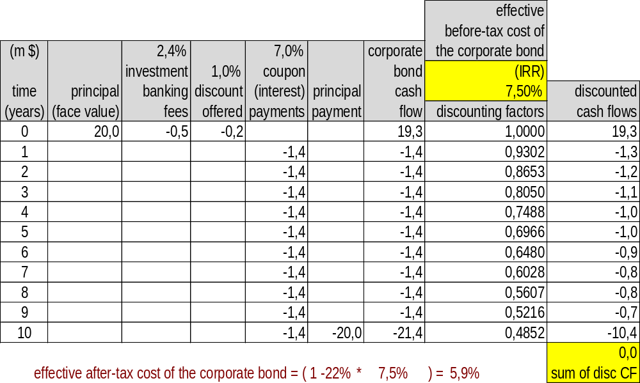
NTE 1010 – Introduction to Finance for Engineers
Yield to Maturity
Effective Cost of a Corporate Bond

Slide 7
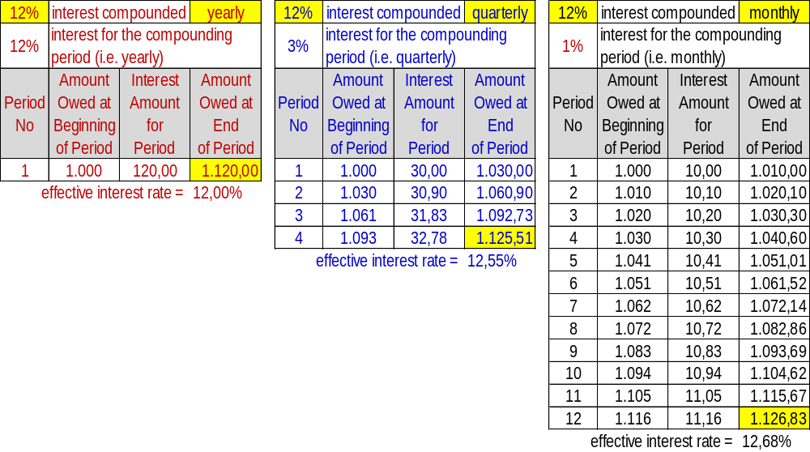
NTE 1010 – Introduction to Finance for Engineers
Compound Interest
Periods with which interest is compounded may vary.
[12% compounded quarterly] is the same as [3% per quarter]; where effective interest rate is 12.55%.
[12% compounded monthly] is the same as [1% per month]; where effective interest rate is 12.68%.
Note that for [12% per year] in other words [12% compounded yearly] effective interest rate is 12%.

Slide 8
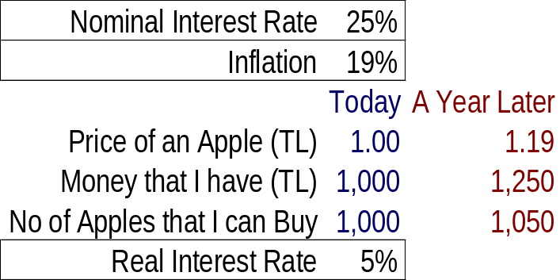
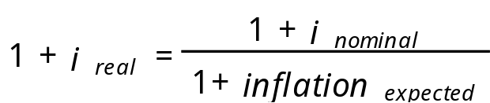
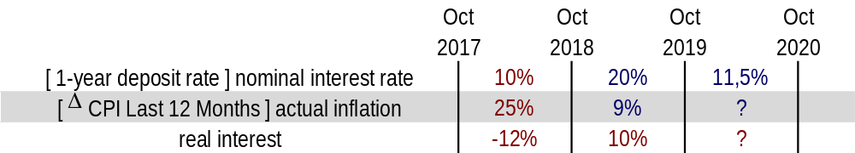
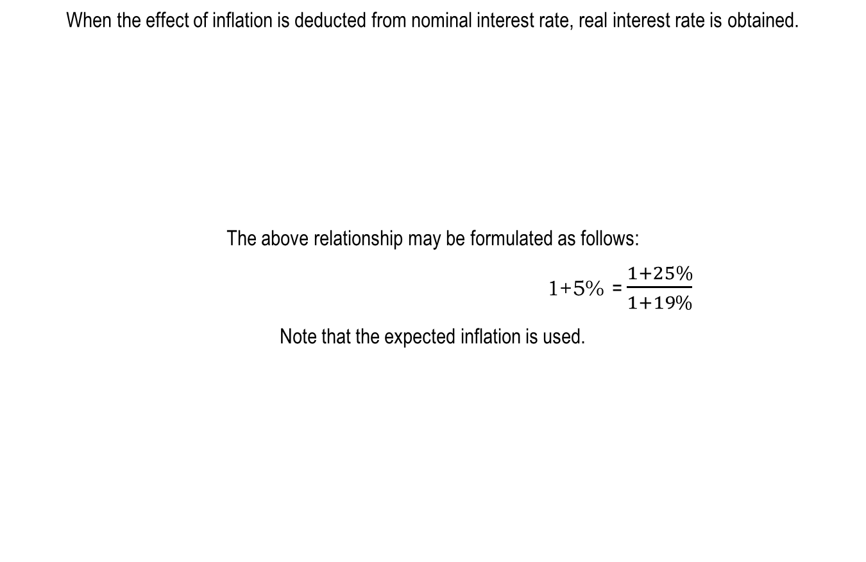
NTE 1010 – Introduction to Finance for Engineers
Interest Rates
Real versus Nominal Interest Rate
When the effect of inflation is deducted from nominal interest rate, real interest rate is obtained.
The above relationship may be formulated as follows:
                1+5% = $\frac{1+25\%}{1+19\%}$
Note that the expected inflation is used.

Slide 9
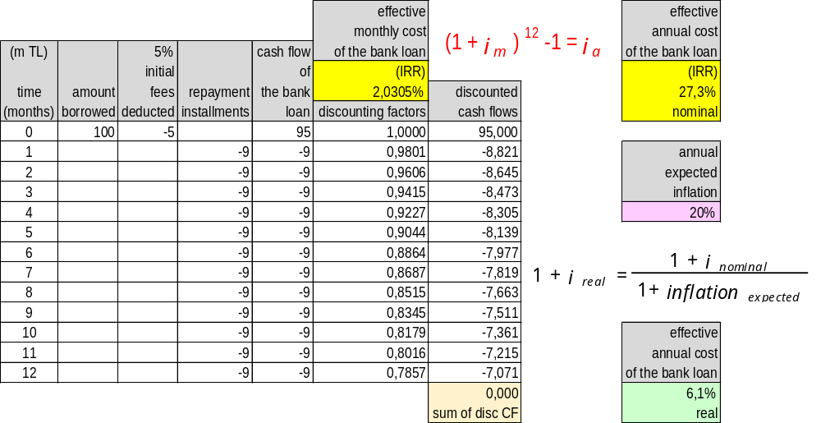
NTE 1010 – Introduction to Finance for Engineers
Effective Cost of a Bank Borrowing which is paid back in equal installments

Slide 10
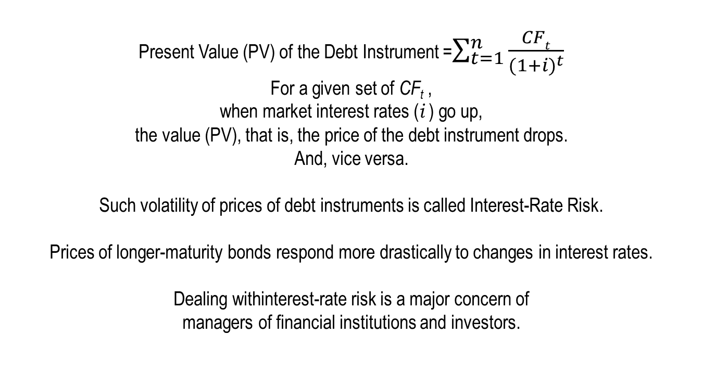
NTE 1010 – Introduction to Finance for Engineers
Interest Rates
Interest-Rate Risk
Present Value (PV) of the Debt Instrument =$\sum_{t=1}^{n}{\frac{CFt}{{(1+i)}^{t}}}$
For a given set of CF_{t} ,
when market interest rates (i ) go up,
the value (PV), that is, the price of the debt instrument drops.
And, vice versa.
Such volatility of prices of debt instruments is called Interest-Rate Risk.
Prices of longer-maturity bonds respond more drastically to changes in interest rates.
Dealing withinterest-rate risk is a major concern of
managers of financial institutions and investors.

Slide 11
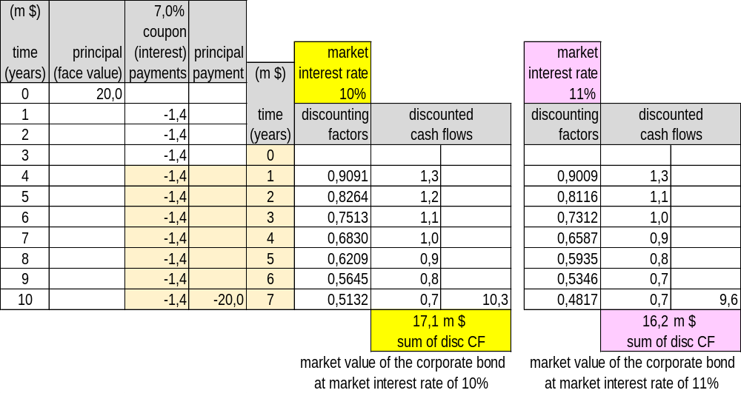
NTE 1010 – Introduction to Finance for Engineers
Interest Rates
Interest-Rate Risk

Slide 12
NTE 1010
Introduction to Finance for Engineers
week 6
Behavior of Interest Rates

Slide 13
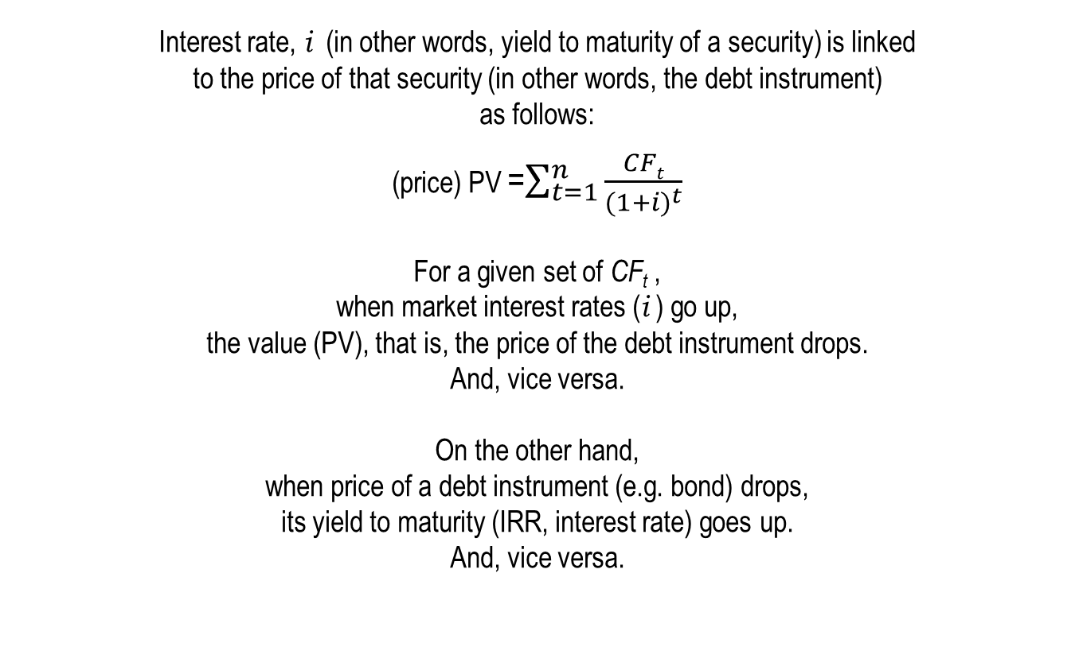
NTE 1010 – Introduction to Finance for Engineers
Behavior of Interest Rates
Asset Price – Yield to Maturity Relationship
Interest rate, i (in other words, yield to maturity of a security) is linked
to the price of that security (in other words, the debt instrument)
as follows:
(price) PV =$\sum_{t=1}^{n}{\frac{CFt}{{(1+i)}^{t}}}$
For a given set of CF_{t} ,
when market interest rates (i ) go up,
the value (PV), that is, the price of the debt instrument drops.
And, vice versa.
On the other hand,
when price of a debt instrument (e.g. bond) drops,
its yield to maturity (IRR, interest rate) goes up.
And, vice versa.

Slide 14
NTE 1010 – Introduction to Finance for Engineers
Behavior of Interest Rates
Determinants of Asset Demand
And, the basic economic theory tells us that
price is determined by demand and supply.
Demand for financial securities (in other words, assets) is affected by the following factors:
Wealth
Ceteris paribus, an increase in wealth raises the quantity demanded of an asset.
Expected Return
An increase in an asset’s expected return relative to that of an alternative asset, raises the demand.
Risk
If an asset’s risk rises relative to that of an alternative asset, its quantity demanded will fall.
Liquidity
The more liquid an asset is relative to alternative assets, the more desirable it is,
and the greater will be the quantity demanded.

Slide 15
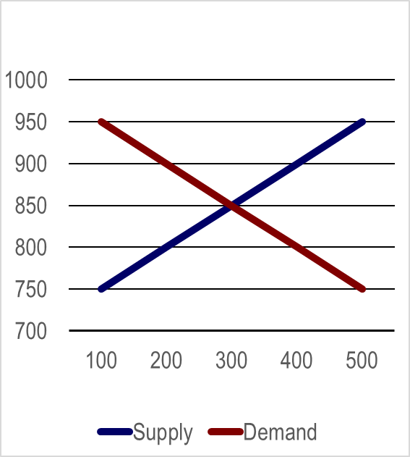
NTE 1010 – Introduction to Finance for Engineers
Behavior of Interest Rates
Supply and Demand in the Bond Market
Price of Bonds,
P ($)
D
S
In economics,
market equilibrium occurs
when the amount
that people are willing to buy (demand)
equals
the amount
that people are willing to sell (supply)
at a given price.
Quantity of Bonds, B ($)

Slide 16
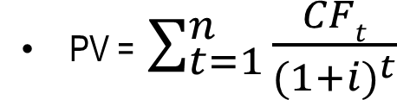
NTE 1010 – Introduction to Finance for Engineers
Changes in Equilibrium Interest Rates
Shifts in Demand for Bonds
When we find out that our wealth has increased, we have more resources available with which to purchase assets,
and so, not surprisingly, the quantity of assets we demand increases.
When the economy is growing rapidly in a business cycle expansion, wealth increases.
Another factor that affects wealth is the public’s propensity to save.
If households save more, wealth increases.
In a business cycle expansion (with growing wealth),
the demand for bonds rises
and the demand curve for bonds shifts to the right.
    Price of bonds go up,
    interest rates drop.
If more people started trading in the bond market, and as a result it became easier to sell bonds quickly, the increase in their liquidity would cause the quantity of bonds demanded at each interest rate to rise. Increased liquidity of bonds relative to alternative assets
results in an increased demand for bonds,
and the demand curve shifts to the right.
Price of bonds go up, interest rates drop.
On the other hand, the reduction of brokarage commissions for trading common stocks that occured when the fixed-rate commission structure was abolished in 1975 in the US, for example, increased the liquidity of stocks relative to bonds, and the resulting lower demand for bonds shifted the demand curve to the left.
Price of Bonds,
P ($)
D’
D
S
Quantity of Bonds, B ($)

Slide 17
NTE 1010 – Introduction to Finance for Engineers
Changes in Equilibrium Interest Rates
Shifts in Demand for Bonds
When we make a decision to buy an asset, we are influenced by what we expect the return on the asset to be. Higher expected interest rates in the future lower the expected return for long-term bonds today, decrease the demand, and shift the demand curve to the left. Changes in expected returns on other assets can also shift the demand curve for bonds.
If people suddenly became more optimistic about the stock market and began to expect higher stock prices in the future,
both expected capital gains and expected returns on stocks would rise.
With the expected return on bonds held constant,
the expected return on bonds today relative to stocks would fall,
lowering the demand for bonds and shifting the demand curve to the left.
    Price of bonds come down,
    interest rates go up.
An increase in expected inflation will lead to higher prices on physical assets (also called real assets) such as cars and houses in the future and hence higher nominal capital gains. The resulting rise in the expected returns today on these real assets will lead to a fall in the expected return on bonds relative to the expected return on real assets today and thus cause the demand for bonds to fall.
An increase in the expected rate of inflation lowers the expected return for bonds, causing their demand to decline and the demand curve to shift to the left. Price of bonds come down, interest rates go up.
If prices in the bond market become more volatile, the risk associated with bonds increases, and bonds become a less attractive asset. An increase in the riskiness of bonds relative to alternative assets causes the demand for bonds to fall and the demand curve to shift to the left.
Price of bonds come down, interest rates go up.
Price of Bonds,
P ($)
S
D’
D
Quantity of Bonds, B ($)

Slide 18
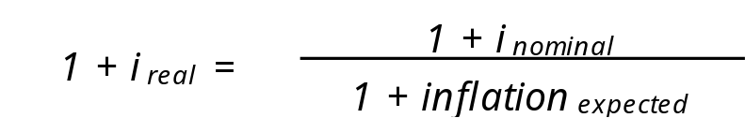
NTE 1010 – Introduction to Finance for Engineers
Changes in Equilibrium Interest Rates
Shifts in Supply of Bonds
The more profitable plant and equipment investments
that a firm expects it can make,
the more willing it will be to borrow for financing these investments.
When the economy is growing rapidly,
investment opportunities that are expected to be profitable abound,
the supply of bonds increases, and the supply curve shifts to the right.
    Price of bonds come down,
    interest rates go up.
The real cost of borrowing is more accurately measured by
the real interest rate,
which equals the (nominal) interest rate less* the expected inflation rate.
When expected inflation increases,
the real cost of borrowing falls;
hence the quantity of bonds supplied increase at any given bond price,
i.e. the supply curve shifts to the right.
Price of bonds come down, interest rates go up.
Government issues bonds to finance government deficits,
the gap between the government’s expenditures and its revenues.
When these deficits are large, the government sells more bonds,
and the quantity of bonds supplied at each bond price increases.
Higher government deficits
increase the supply of bonds and shift the supply curve to the right.
Price of bonds come down, interest rates go up.
Price of Bonds,
P ($)
D
S
S’
Quantity of Bonds, B ($)

Slide 19
NTE 1010
Introduction to Finance for Engineers
week 6
The Risk and Term Structure
of Interest Rates

Slide 20
NTE 1010 – Introduction to Finance for Engineers
Risk Structure of Interest Rates
Default Risk
One attribute of a bond that influences its interest rate is its risk of default,
which occurs when the issuer of the bond is unable or unwilling to
make interest payments when promised
or pay off the face value when the bond matures.
Government bonds have usually been considered to have no default risk
because the government can always increase taxes or print money to pay off its obligations;
they are called default-free bonds.
The spread between the interest rates on bonds with default risk and default-free bonds,
both of the same maturity,
called the risk premium,
indicates how much additional interest people must earn
to be willing to hold that risky bond.
Purchasers of bonds need to know whether a Corporation is likely to default on its bonds;
this information is provided by credit-rating agencies.

Slide 21
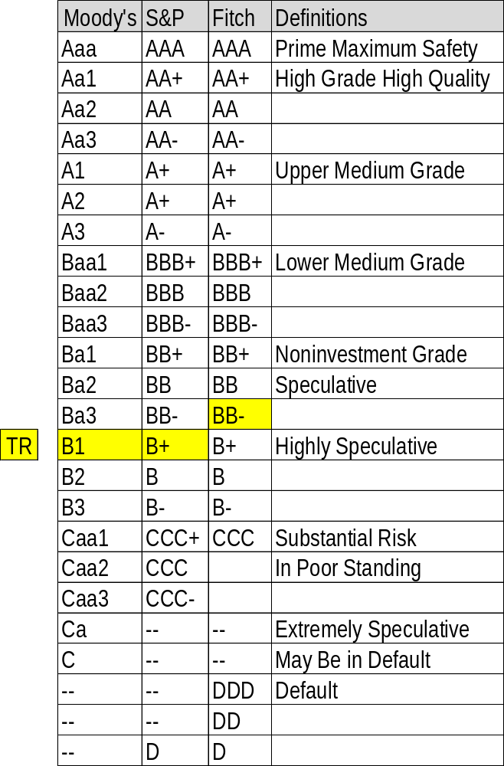
NTE 1010 – Introduction to Finance for Engineers
Risk Structure of Interest Rates
Bond Ratings

Slide 22
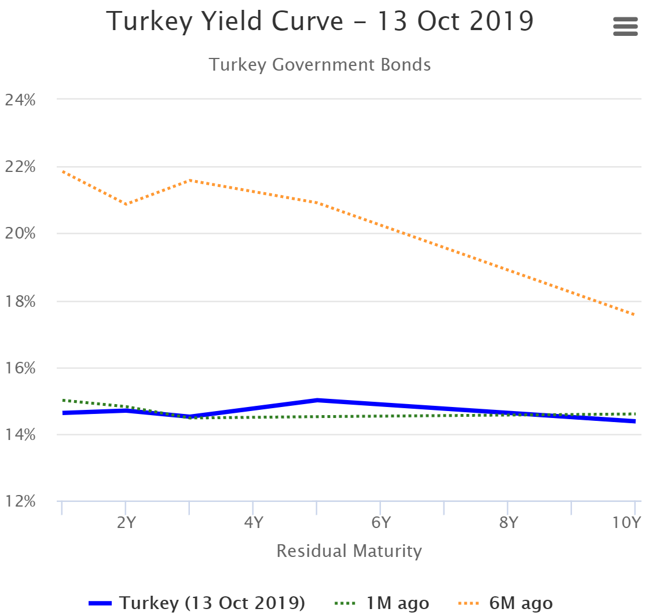
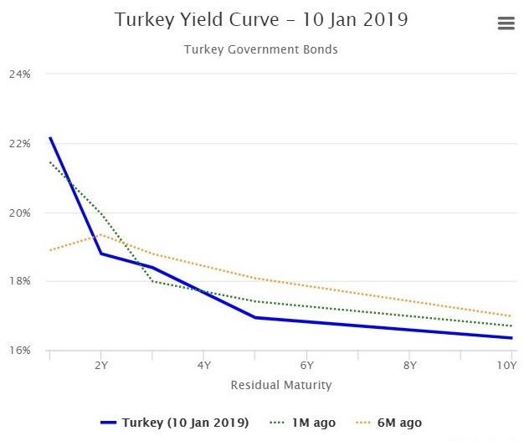
NTE 1010 – Introduction to Finance for Engineers
Term Structure of Interest Rates
Yield Curve
A plot of the yields on bonds with differing terms to maturity
but the same risk, liquidity, and tax considerations is called a yield curve,
and it describes the term structure of interest rates for particular types of bonds.
24%
16%

Slide 23
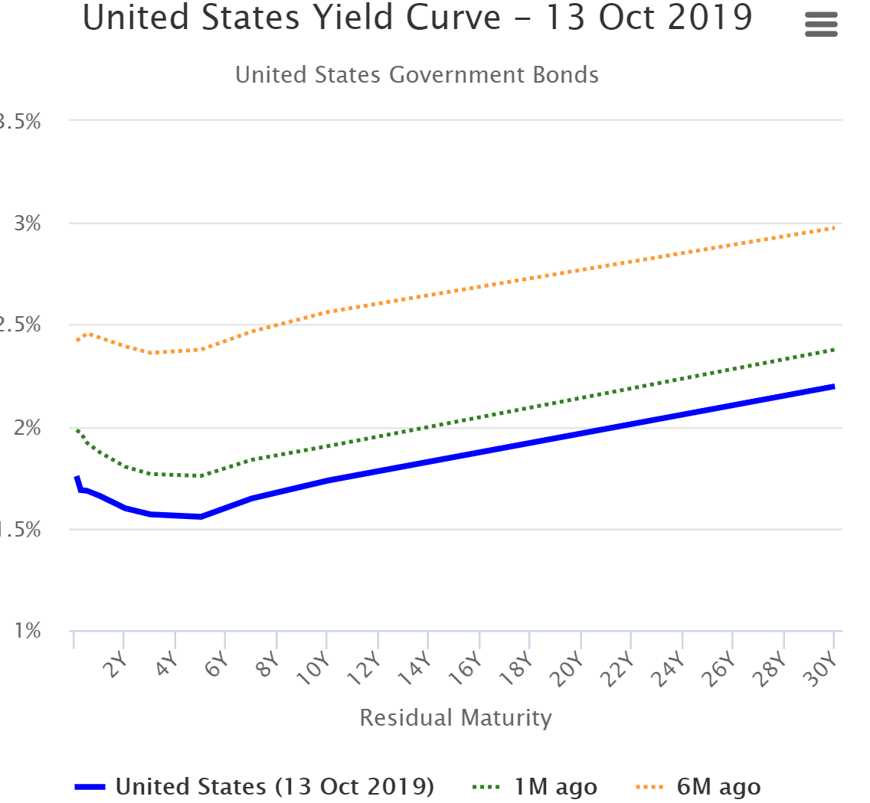
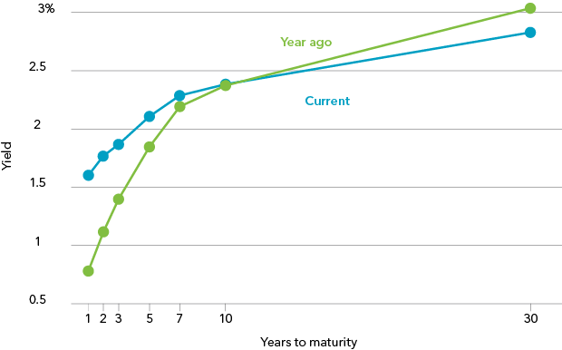
NTE 1010 – Introduction to Finance for Engineers
Term Structure of Interest Rates
Yield Curve
A plot of the yields on bonds with differing terms to maturity
but the same risk, liquidity, and tax considerations is called a yield curve,
and it describes the term structure of interest rates for particular types of bonds.
US Yield Curve
3%
1.5%

Slide 24
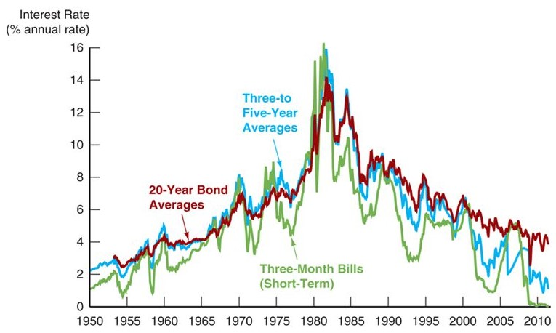
NTE 1010 – Introduction to Finance for Engineers
Term Structure of Interest Rates
Movements over Time of Interest Rates on US Government Bonds with Different Maturities

Slide 25
NTE 1010 – Introduction to Finance for Engineers
Term Structure of Interest Rates
Yield Curve
A plot of the yields on bonds with differing terms to maturity
but the same risk, liquidity, and tax considerations is called a yield curve,
and it describes the term structure of interest rates for particular types of bonds.
Three empirical facts about term structure of interest rates are:
  Interest rates on bonds of different maturities move together over time.
  When short-term interest rates are low, yield curves are more likely to have an upward slope;
  when short-term interest rates are high, yield curves are more likely to slope downward (i.e. inverted).
  Yield curves almost always slope upward.
Three theories have been put forward to explain the term structure of interest rates,
i.e. shapes of yield curves:
            The Expectations theory
            The Segmented Markets theory
            The Liquidity Premium theory

Slide 26
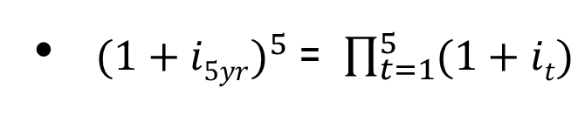
NTE 1010 – Introduction to Finance for Engineers
Term Structure of Interest Rates
Expectations Theory
″The interest rate on a long-term bond will equal
an average of the short-term interest rates
that people expect to occur over the life of the long-term bond.″
For a 5-year bond, the yield formulation would be as follows:
When the yield curve is upward-sloping,
the expectations theory suggests that
short-term interest rates are expected to rise in the future.

Slide 27
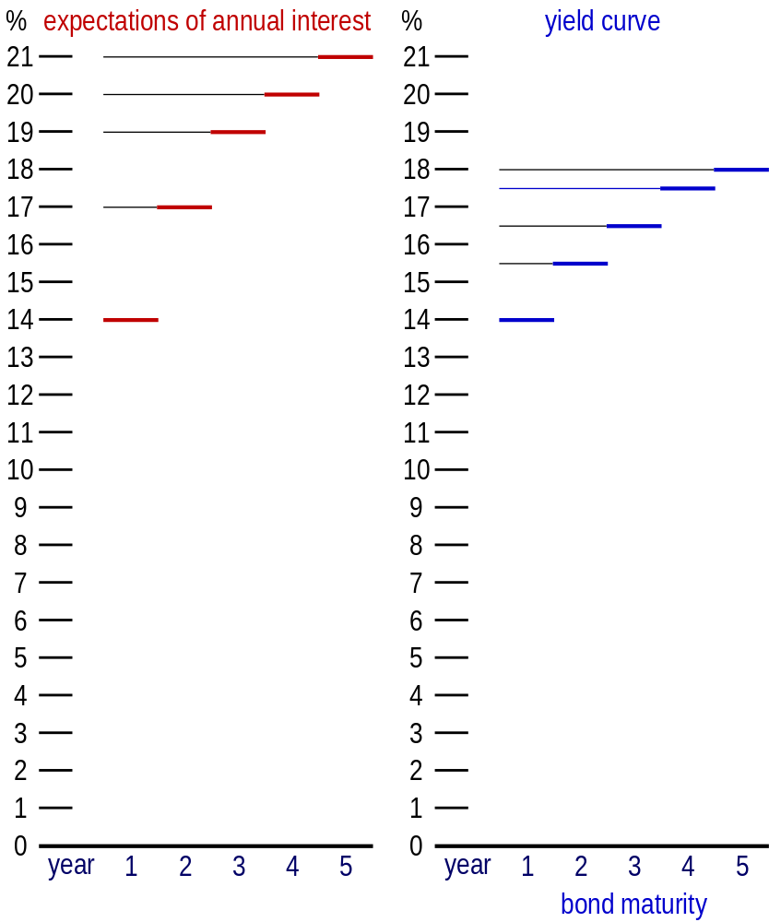
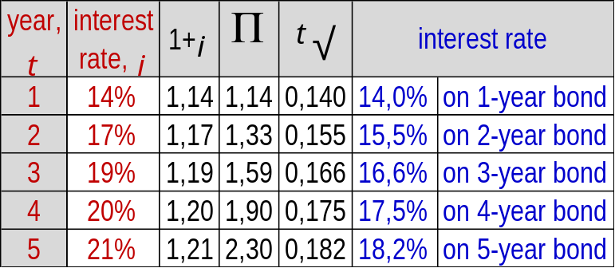
NTE 1010 – Introduction to Finance for Engineers
Term Structure of Interest Rates
Expectations Theory
If expectation of annual interest rates
for the next 5 years
is as follows,
what would be the yield curve
according to the expectations theory?

Slide 28
NTE 1010 – Introduction to Finance for Engineers
Term Structure of Interest Rates
Segmented Markets Theory
The segmented markets theory of the term structure
sees markets for different-maturity bonds as completely separate and segmented.
The interest rate for each bond with a different maturity
is then determined by the supply and demand for that bond,
with no effects from expected returns on other bonds with other maturities.
This theory of the term structure is at the opposite extreme to
the expectations theory, which assumes that bonds of different maturities are perfect substitutes.
According to the segmented market theory,
as risk averse investors generally prefer bonds with shorter maturities that have less interest-rate risk,
the demand for long-term bonds is relatively lower than that for short-term bonds;
long-term bonds will have lower prices and higher interest rates,
and hence the yield curve will typically slope upwards.
However, the segmented market theory fails to explain the other two empirical facts about yield curves:
Interest rates on bonds of different maturities move together over time.
When short-term interest rates are low, yield curves are more likely to have an upward slope;
when short-term interest rates are high, yield curves are more likely to slope downward (i.e. inverted).

Slide 29
NTE 1010 – Introduction to Finance for Engineers
Term Structure of Interest Rates
Liquidity Premium Theory
This theory states that the interest rate on a long-term bond will equal
an average of short-term interest rates expected to occur over the life of the long-term bond
(as in the Expectations theory)
plus a liquidity premium (also referred to as term premium)
that responds to supply and demand conditions for that bond.
Bonds of different maturities are assumed to be substitutes
but not perfect substitutes.
Investors tend to prefer short-term bonds
because these bonds bear less interest-rate risk.
For these reasons,
investors must be offered a positive liquidity premium
to induce them to hold longer-term bonds.

Slide 30
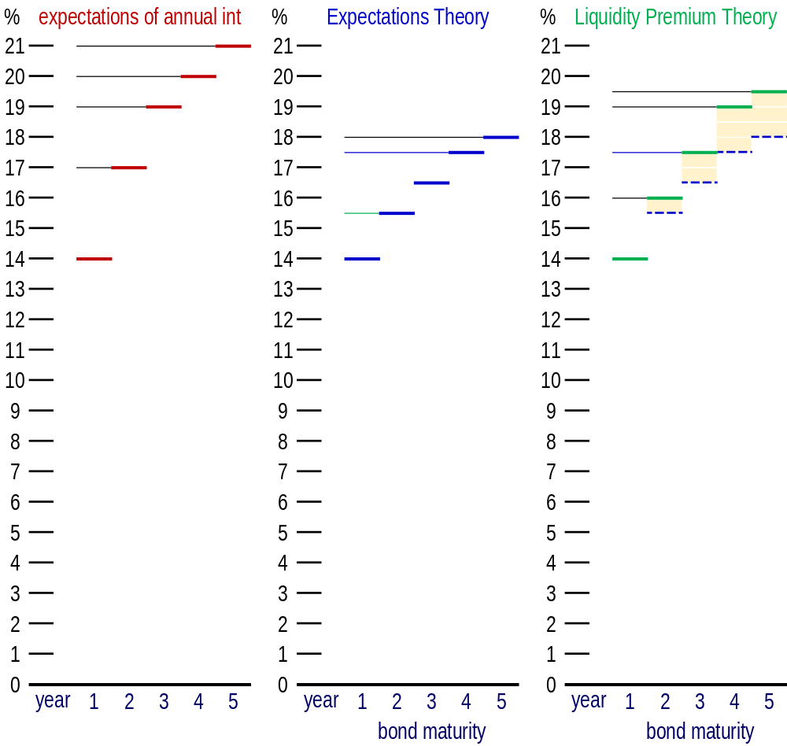
NTE 1010 – Introduction to Finance for Engineers
Term Structure of Interest Rates
Liquidity Premium Theory
Because
the liquidity premium
is always positive
and grows
as the term to maturity
increases,
the yield curve implied by the liquidity premium theory
is always above
the yield curve implied by the expectations theory and
has a steeper slope.

Slide 31
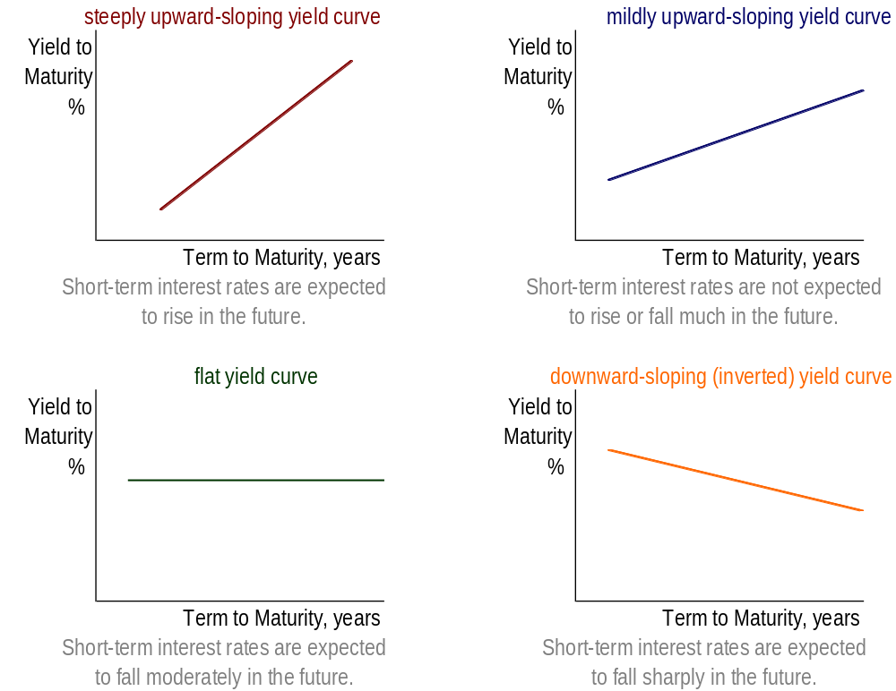
NTE 1010 – Introduction to Finance for Engineers
Term Structure of Interest Rates
Liquidity Premium Theory

